Slide 1

OSLO Core Consent
Welcome! We will start at 1:05pm.
Thursday 18th November 2021
Virtual Workshop - Microsoft Teams
Digitaal Vlaanderen

Slide 2

Purpose of today
Summarise the second thematic workshop
Present the new iteration of the data model (including attributes)
Further elaborate the use cases

Slide 3



Practicalities
Sound of the audience is muted by default.
Use the hand if you want to say something. Interaction is encouraged!
Questions, comments and suggestions can be communicated via the chat function. Interaction is encouraged!
Yes/No questions can be answered via the chat:
Agree = +1
Disagree = - 1
Indifferent = 0

Slide 4

Recording

Slide 5


Agenda
Welcome: Who is who 5 min
Summary of the previous workshop 20 min
New iteration of the data model 60 min
15 min. break
Use cases 40 min
Q&A and next steps 10 min

Slide 6

Who is who?
5’
https://app.mural.co/t/beadvtc7549/m/beadvtc7549/1637147210499/f01f867891584f4f61d96e7a445b15496e21dcca?sender=u91199267117038c13b019919

Slide 7
Rationale for this trajectory
Digitaal Vlaanderen

Slide 8
What is TRAPEZE?
TRAPEZE is a project, financed by the European Commission, that delivers a platform as a solution for organisations and citizens with some concrete objectives on security and privacy.
It aims to:
Bring stakeholders together under a common framework;
Provide citizens with the necessary tools and know-how to manage their security and privacy;
Supporte consent mechanisms and verifying that data is used appropriately;
Restore citizens' trust in the digital economy by implementing 'log integrity' and 'non-repudiation';
Build up 'data lineage' and 'transparency by design' and
Illustrate its usefulness by applicing it in 3 domains, namely government, telecom and financial sector.

Slide 9
What is expected?
Common data standard for “consent”
The objective of this project is to manage the consent of an agent’s data exchange in a uniform, standardised and machine-interpretable manner.
2-part objective, namely:
OSLO trajectory
Application profile for a wide range of use cases, i.e.:
As a citizen
As a business party using a permission
Use cases relating to delegation of consent
Co-creative trajectory for the development of an unequivocal data standard concerning core consent.
Involving the main stakeholders (federal and regional authorities, local authorities, private organisations) in order to develop a data standard that is supported as broadly as possible

Slide 10
Summary of the previous workshop
Digitaal Vlaanderen

Slide 11


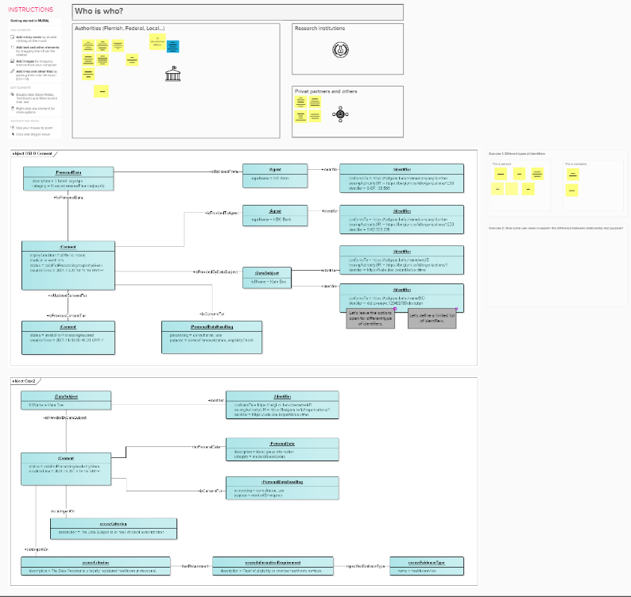
What did we do in the previous workshop?
Discussion context model via use cases
Solving main issues from thematic workshop 1
Brainstorm session
Give consent to salary data for a mortgage loan
Give consent to blood group info in case of a medical emergency
Balance between simplicity and specificity of consents
Relationship between data subject and data consumer versus purpose
Contextual requirements for the Consent to be valid
Consent given to Agents with the necessary credentials
Expression of expiry conditions
Identification of Agents

Slide 12
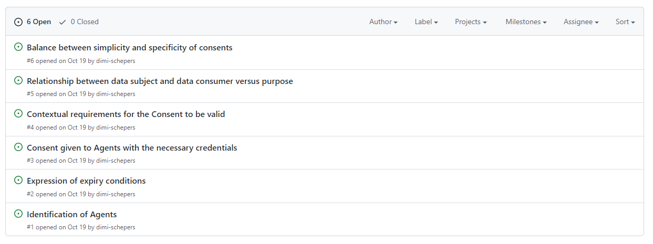
Key takeaways from workshop 2
The 2nd thematic workshop mainly focused on the issues identified during the previous workshops. Hence, how we agreed to handle these issues can be used as the basis to formulate the key takeaways of the workshop.

Slide 13
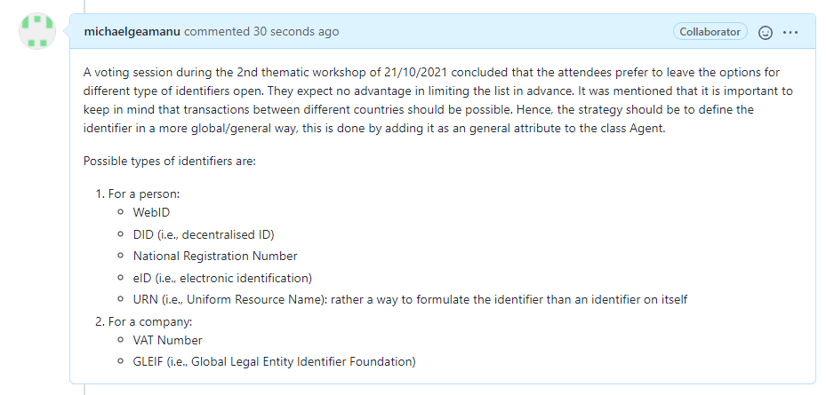
Issue nr. 1: Identification of Agents

Slide 14
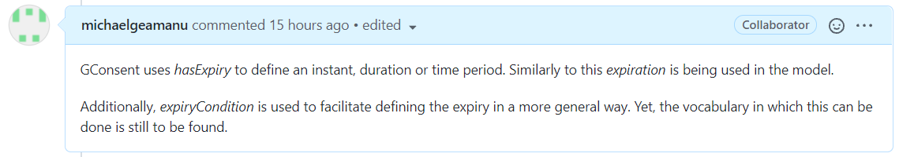
Issue nr. 2: Expression of expiry conditions

Slide 15
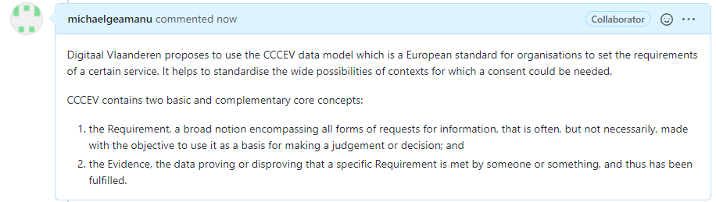
Issue nr. 3: Consent given to Agents with the necessary credentials

Slide 16
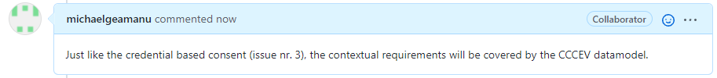
Issue nr. 4: Contextual requirements for the Consent to be valid

Slide 17
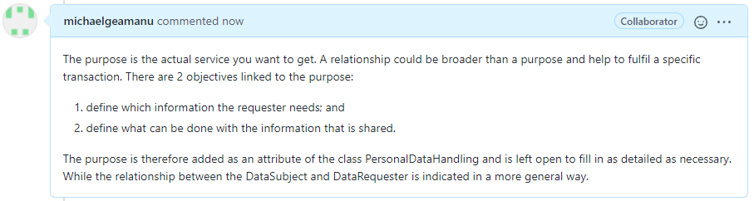
Issue nr. 5: Relationship between data subject and data consumer versus purpose

Slide 18
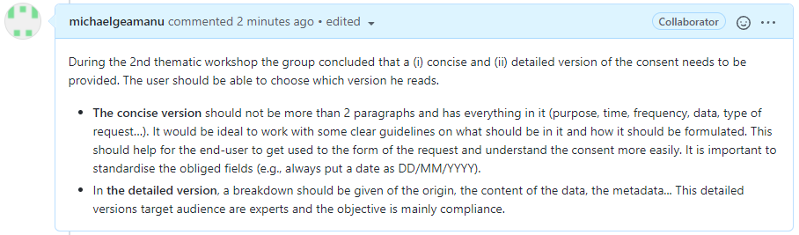
Issue nr. 6: Relationship between data subject and data consumer versus purpose

Slide 19
Other takeaways of the previous workshop
The legal validity of the model needs to be checked. This is currently being followed up by PwC.
It is good to keep a chain of consent to have an audit trail. Important here is to keep the most recent version of the consent as the first one in the chain.
The DataSubject should be able to cancel a consent, while adjustments to a consent should be controlled carefully. This can be solved by the status of the consent.

Slide 20
What does the planning look like?
OSLO-traject
Start date: 19th of August 2021
Duration: 8 months
19th of August
23th of September
18th of November
16th of December
January - March
21th of October
Business workshop
Thematic workshop 1
Thematic workshop 3
Thematic workshop 4
Implementation of the draft specifications
Thematic workshop 2
Today

Slide 21
New iteration of the data model
Digitaal Vlaanderen

Slide 22
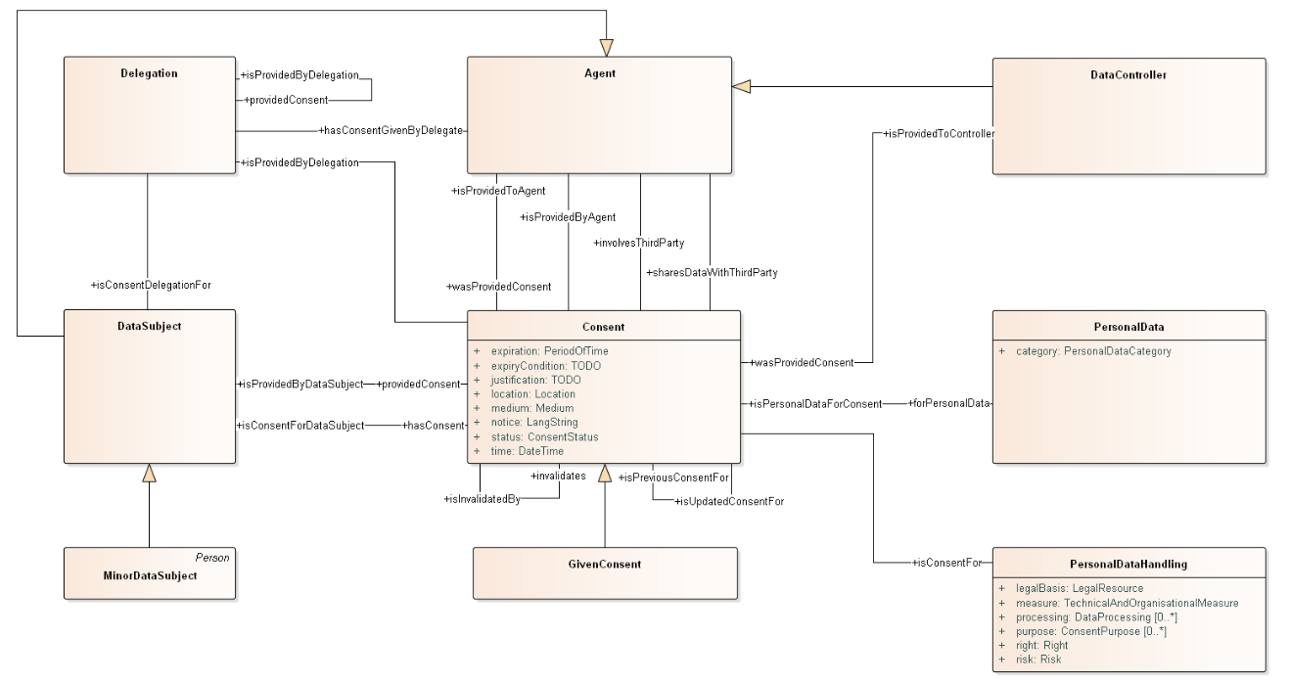
Previous iteration of the data model

Slide 23

High level changes to the first draft model
The different agents within Consent are all added to the model and the class Agent has become an abstract class
Added identifiers to the model and kept the options open for all types of identifiers
CCCEV datamodel will be used to define contextual and conceptual consents
Elaborated on the attributes in several classes:
For PersonalData to capture a higher level of granularity
Added “Withdrawn” and “Expired” to the Consent status
Purpose has been added to PersonalDataHandling

Slide 24
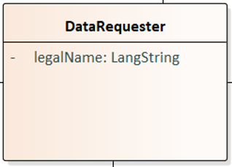
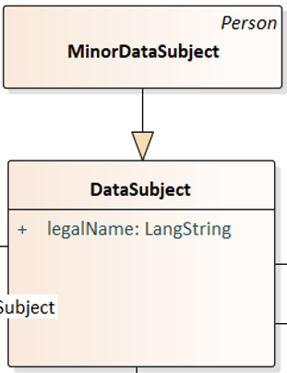

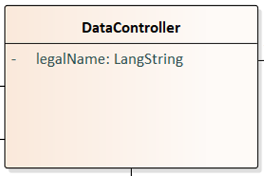
1. Different Agents within Consent
Different Agent have been defined following several reasons:
This makes it possible to show the relationships between the different agents
Shows clearly who is the DataRequester
DataController ensures that the DataSubject knows exactly who is providing the data
DataSubject: Person or entity that gives or delegates consent to share his data.
DataRequester: Entity that requests the data.
DataController: Entity that provides the data.

Slide 25
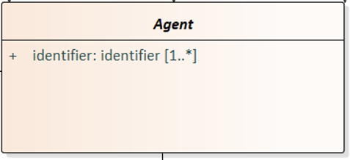
2. Agent as super class with the attribute identifier
Agent has been changed to an implicit class as the super class of DataSubject, DataController and DataRequester.
The attribute identifier is added to the model to unambiguously identify the parties involved in the consent activity.
The attribute is kept generalistic and open to make it possible to decide on application level which identifier suites best.

Slide 26
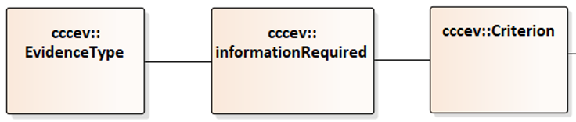
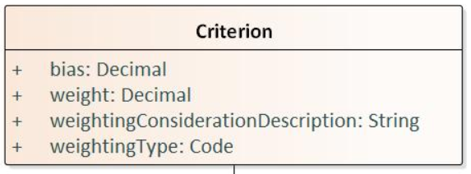
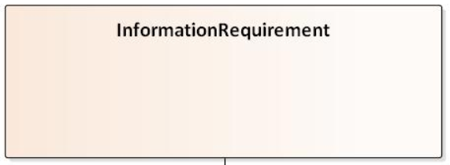
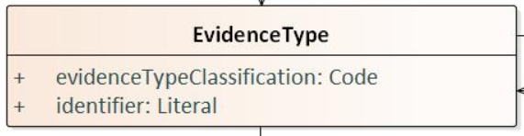
3. CCCEV classes have been added
To be able to cover the requirements for contextual and credential consent, the CCCEV classes Criterion, InformationRequired and EvidenceType have been added.
CCCEV is a European standard for organisations to set the requirements of a certain service. Based on the criterion (used as the basis for making a decision) and the evidence (proving that something is true).
Datamodel itself does not verify the criteria and evidences but the classes standardise the information needed for a machine to make automatic reasoning possible on the criteria and answers.

Slide 27
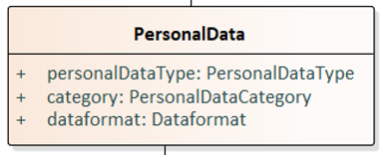
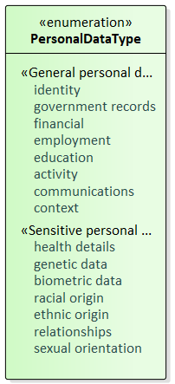
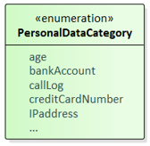
4. Higher granularity for PersonalData
Within previous workshops we highlighted that we would like the granularity of the PersonalData to be as high as possible (ideally up until field level).
Hence, we added some attributes that should help to define the data that is asked for:
PersonalDataType are types defined on European level, while the category can be used to further define the data.
PersonalDataCategory is unlimited and the category is used to further define the data.
Dataformat is also added to detail the technical requirements of the data

Slide 28
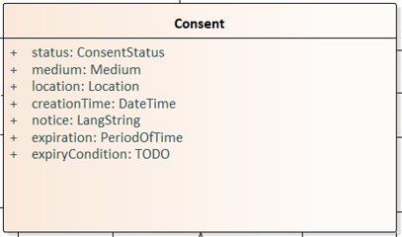
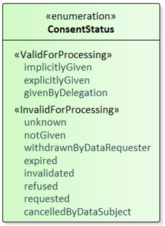
5. Extra options for the status of Consent
Within consent a few attributes have been changed. With an extra attention point for the status of the consent.
time had been changed to creationTime to make is less ambiguous and will be used to timestamp the changes in the consent.
Attribute justification is deleted
On the ConsentStatus:
“cancceledByDataSubject”: if a DataSubject has decided to cancel the given consent
“withdrawnByDataRequester”: if a DataRequester wants to withdraw the consent request (e.g., due to an error in the request)

Slide 29
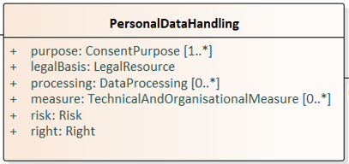
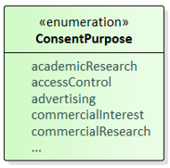
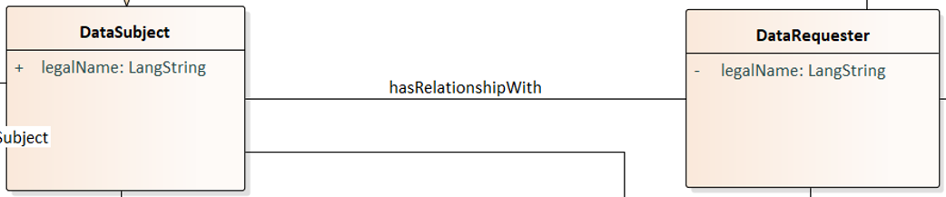

6. Purpose and relationship within the model
Objective of the purpose:
To define the information the requester needs and define what can be done with the information. It is the actual service you want to get.
Relationship:
A broader concept that defines the relationship between the DataSubject and the DataRequester which shows the involvement they have with each other.

Slide 30
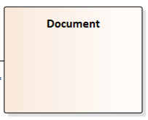
7. Adding the class Document
To give an agent the possibility to check what (s)he has given consent to we propose to add the class Document to the datamodel. With this class being an English version of the class Document from OSLO Contactvoorkeuren.
Definition of Document in OSLO Contactvoorkeuren: A document containing detailed information on the identity of the persons responsible, the planned processing, the purpose and legal basis and on the measures taken to protect the data.

Slide 31
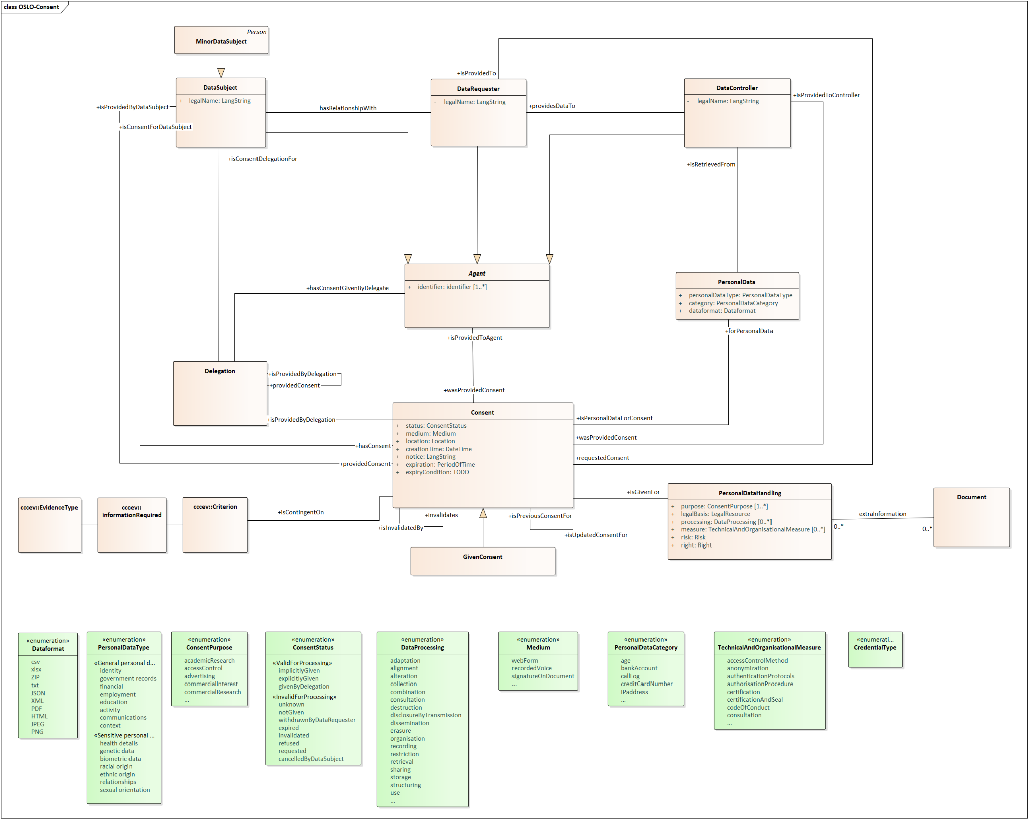
Current iteration of the data model

Slide 32

A short break...

Slide 33

Welcome back!

Slide 34
Use cases
Digitaal Vlaanderen

Slide 35
Case 1 – Give consent to salary data for a mortgage loan
Kate is a customer of KBC bank. She has both a current and a savings account. Recently, she has her eyes set on a house, and applies for a mortgage loan at KBC. KBC requests her payslips to verify her eligibility and to calculate an appropriate interest rate. Kate gives consent for this via a web form and specifies that the requested data can be retrieved from SD Worx. She also specifies that her consent will be withdrawn once the offer is made. KBC gives Kate an offer for her mortgage loan.

Slide 36
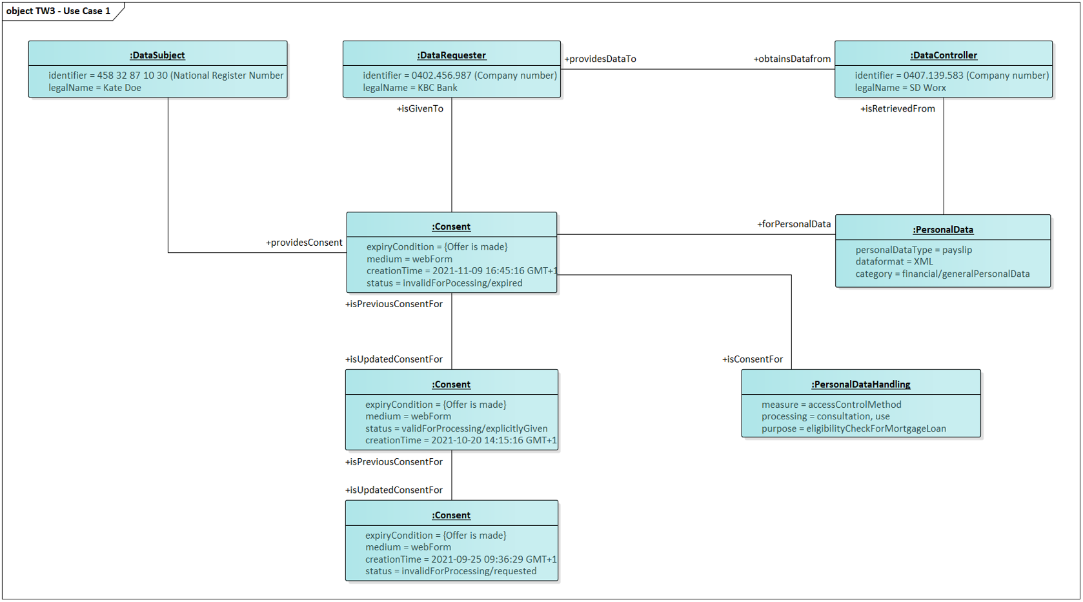
Case 1 – Give consent to salary data for a mortgage loan

Slide 37
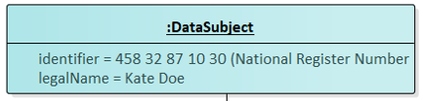
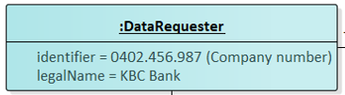
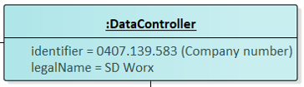
Agents
Agent is the superclass and its subclasses are:
DataSubject
identifier = 458 32 87 10 30 (National Register Number)
legalName = Kate Doe
DataRequester
identifier = 0402.456.987 (Company number)
legalName = KBC Bank
DataController
identifier = 0407.139.583 (Company number)
legalName = SD Worx

Slide 38
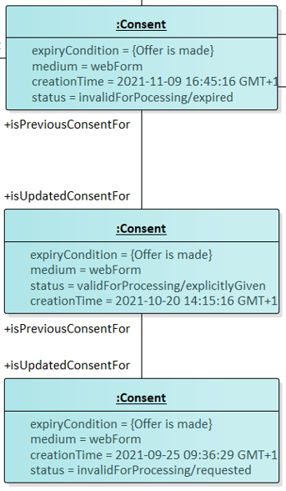
Consent
expiryCondition = {Offer is made}
medium = webForm
creationTime = 2021-11-09 16:45:16 GMT+1
status = invalidForProcessing/expired
expiryCondition = {Offer is made}
medium = webForm
status = validForProcessing/explicitlyGiven
creationTime = 2021-10-20 14:15:16 GMT+1
expiryCondition = {Offer is made}
medium = webForm
creationTime = 2021-09-25 09:36:29 GMT+1
status = invalidForProcessing/requested

Slide 39
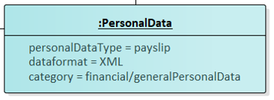
PersonalData
personalDataType = financial/generalPersonalData
dataformat = XML
category = payslip

Slide 40
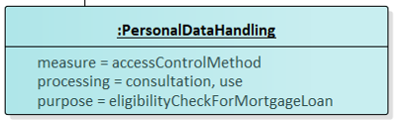
PersonalDataHandling
measure = accessControlMethod
processing = consultation, use
purpose = eligibilityCheckForMortgageLoan

Slide 41
Case 2 – Give consent to blood group info in case of a medical emergency
On her way back from the bank, Kate is involved in a car accident. She is rushed to the hospital and is in urgent need of a blood administration. Kate is unconscious, but luckily, she has already given consent to access her blood group in the past in case of medical emergencies w.r.t. healthcare professionals.

Slide 42
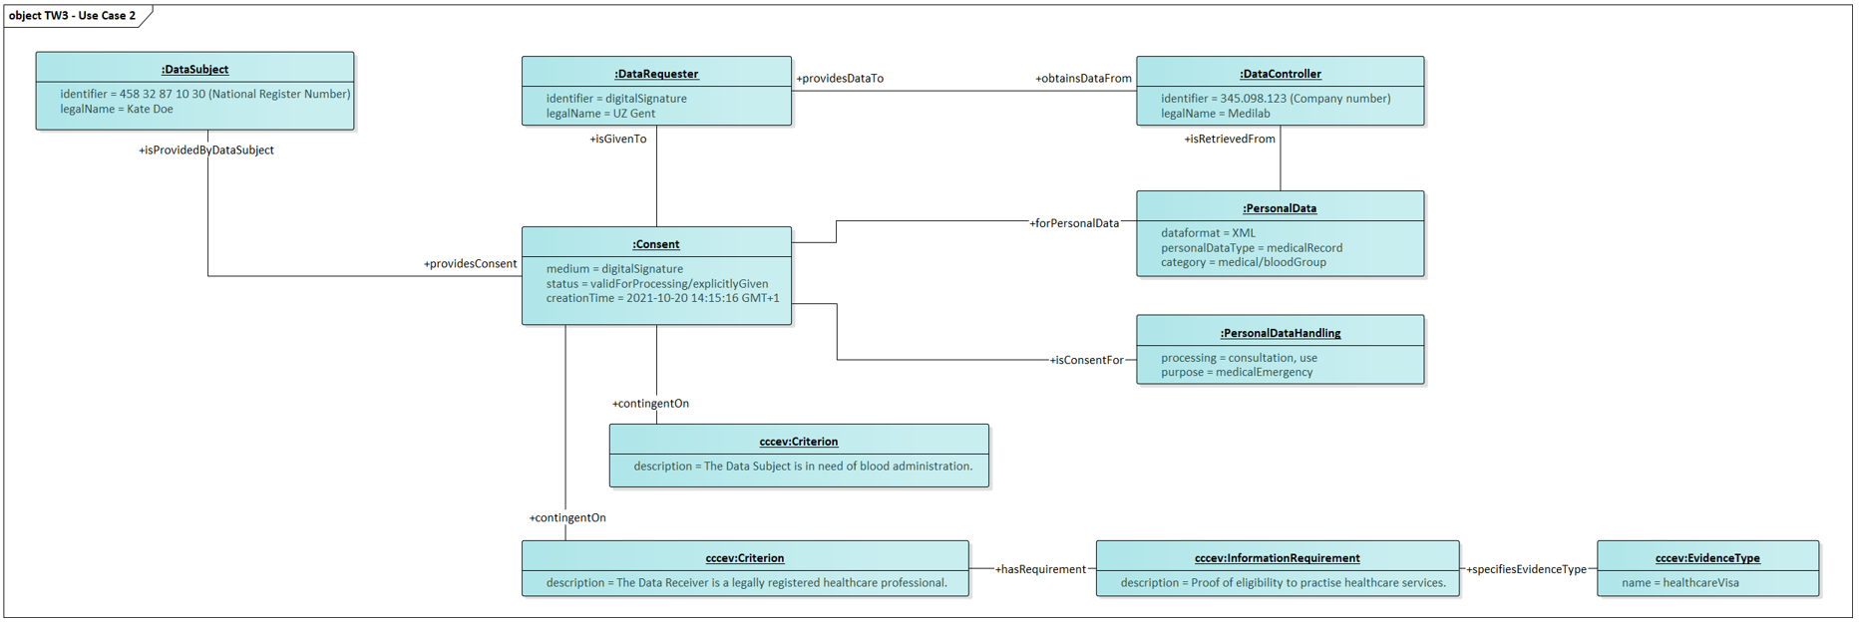
Case 2 – Give consent to blood group info in case of a medical emergency

Slide 43
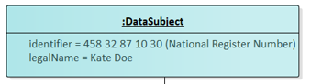
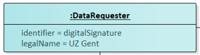
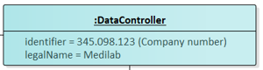
Agents
Agent is the superclass and its subclasses are:
DataSubject
identifier = 458 32 87 10 30 (National Register Number)
legalName = Kate Doe
DataRequester
identifier = digitalSignature
fullName = UZ Gent
DataController
identifier = 345.098.123 (Company number)
fullName = Medilab

Slide 44
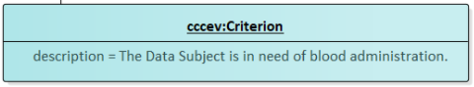
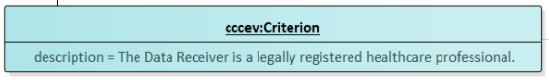
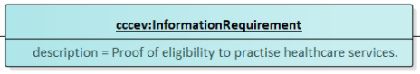
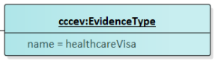
CCCEV
cccev::Criterion
description = The Data Subject is in need of blood administration.
cccev::Criterion
description = The Data Receiver is a legally registered healthcare professional.
cccev::InformationRequired
description = ¨Proof of eligibility to practise healthcare services
cccev::EvidenceType
name = healtcareVisa

Slide 45
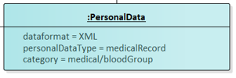
PersonalData
dataformat = XML
personalDataType = medicalRecord
category = medical/bloodGroup

Slide 46
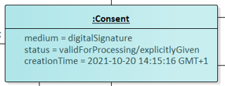
Consent
medium = digitalSignature
status = validForProcessing/explicitlyGiven
creationTime = 2021-10-20 14:15:16 GMT+1

Slide 47
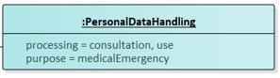
PersonalDataHandling
processing = consultation, use
purpose = medicalEmmergency

Slide 48
Q&A and next steps
Digitaal Vlaanderen

Slide 49

Why do we do ... ?
Wouldn’t it be better if we ... ?
Don’t we need to add ... ?
What about ... ?

Slide 50
Next steps
Process all input from this workshop
Send out the report from this workshop. Feedback is certainly welcome!
Capture feedback via GitHub on data model and report via GitHub !

Slide 51

Feedback
Feedback can be given via mail to the contacts below:
laurens.vercauteren@pwc.com
michael.geamanu@pwc.com
lora.van.looveren@pwc.com
Feedback can be given via GitHub on the link below:
https://github.com/Informatievlaanderen/OSLOthema-consent

Slide 52
Thematic workshop (OSLO)
Next workshop
19th
Business
werkgroep
21th
Thematic
workshop 2
16th
Thematic
workshop 4
August
September
October
November
December
23th
Thematic workshop 1
18th
Thematic
workshop 3
23th
Start public
review
Today
Don’t forget to register!
https://overheid.vlaanderen.be/opleiding/oslo-trapeze?_cldee=a2V2aW4uaGFsZXlkdEB2bGFhbmRlcmVuLmJl&recipientid=contact-6ce4a8517dd3e811a972000d3ab98582-989da9acbb4241e4829946d2e8a0e828&esid=a14015bf-09d4-eb11-bacc-000d3adccc13

Slide 53
Thank you!

